Slide 1
Bag of activities VS DECLARE rules
Bag of activities: features are activity frequencies
Xgboost is used as classifier
Factors to consider before the analysis:
Frequencies are not bounded; confidence is between 0 and 100
Less than 20 features (bag) vs thousands of features (DECLARE)
Bag of activities is faster and requires less RAM
 | ER Registration | Leucocytes | CRP | LacticAcid | …
Case A | 1 | 7 | 2 | 1 | …
Case ZV | 1 | 2 | 2 | 1 | …
… | … | … | … | …. | ….

Slide 2
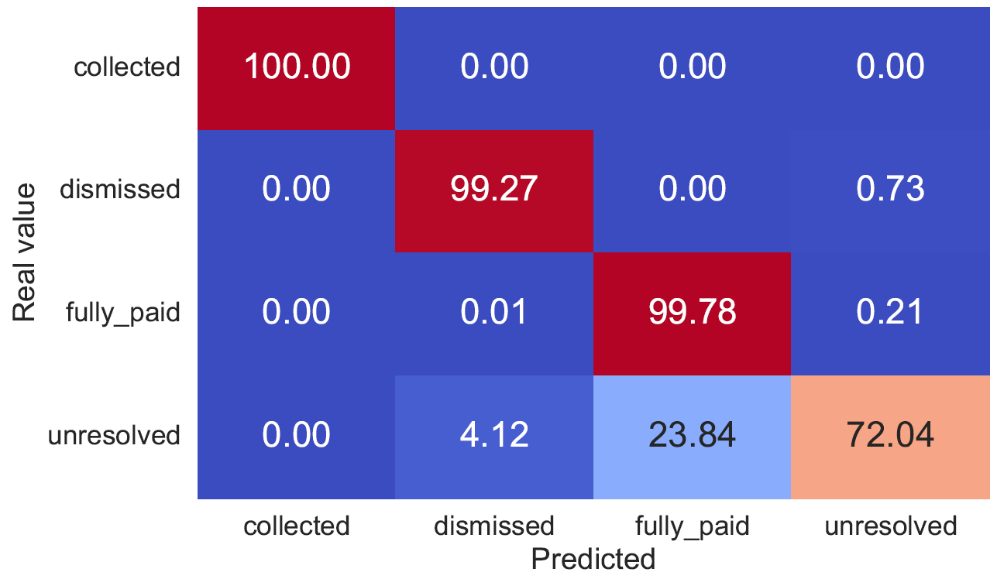
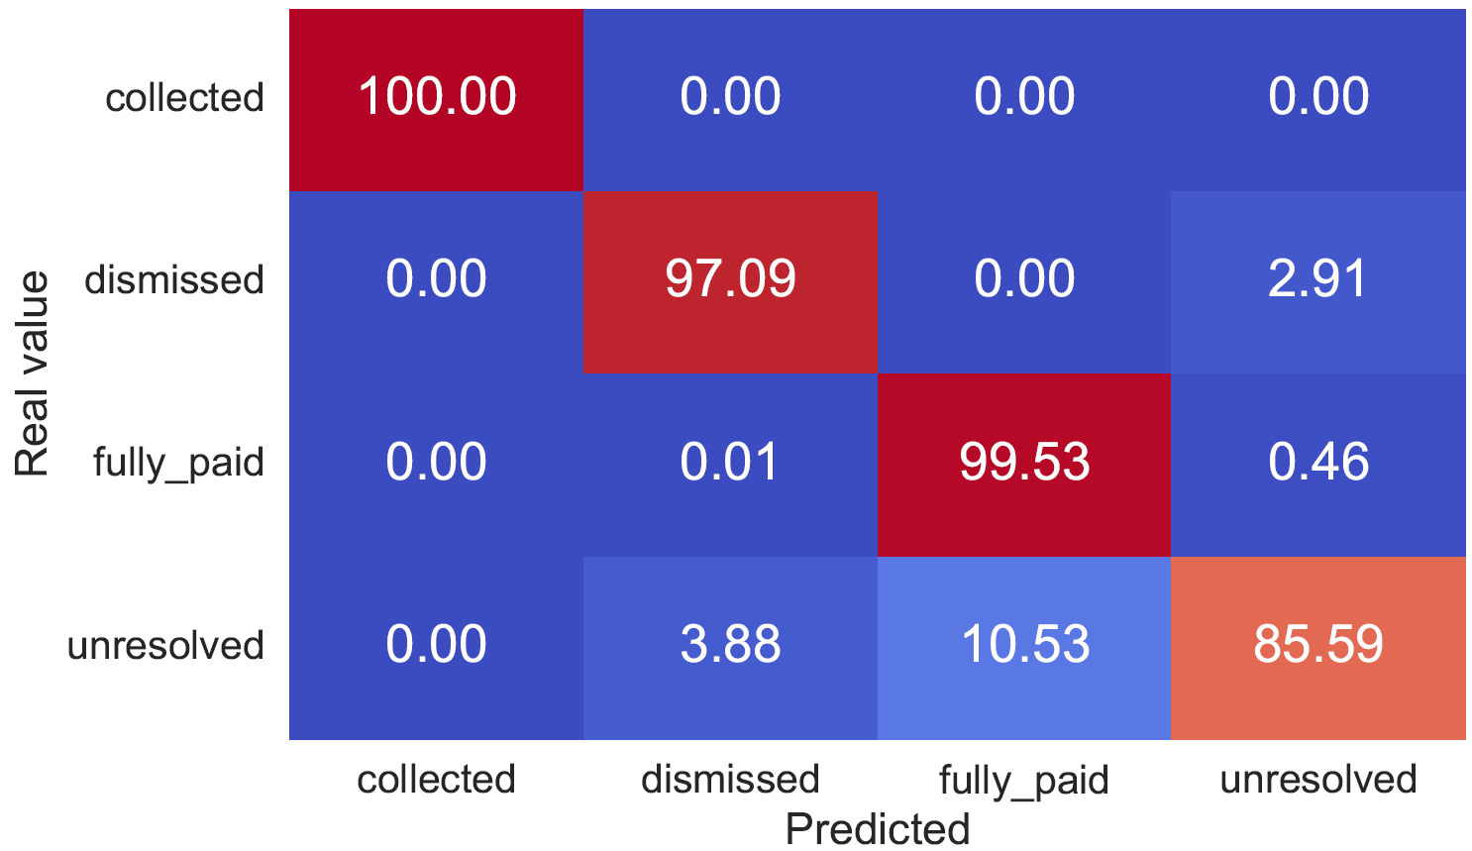
Bag of activities vs DECLARE rules
RTFM
Bag of activities
Declare rules
Unresolved performance difference explanation: it requires a complex relation rather than activity occurrences

Slide 3
Bag of activities vs DECLARE rules
RTFM prototypes:
Bag of activities:
Collected: CF, SF, IF, AP, SC
Dismissed: CF, SF, IF, AP, ID, RP, NR, AJ
Fully paid: CF, PYM
Unresolved CF, SF
DECLARE rules:
Collected: CF, SF, IF, AP, SC
Dismissed: CF, SF, IF, AP, AJ
Fully paid. CF, PYM
Unresolved CF, SF

Slide 4
Bag of activities vs DECLARE rules
RTFM boundary cases dismissed-unresolved
Bag of activities:
Dismissed: CF, SF, IF, ID, SA, RP, AP, NR, AJ
Unresolved: CF, SF, IF, ID, AP, RP, AJ, SA
DECLARE rules:
Dismissed: CF, SF, IF, AP, ID, SA
Unresolved: CF, SF, IF, AP, ID, SA, RP, NR, AJ

Slide 5
Bag of activities vs DECLARE rules
RTFM boundary cases fully paid-unresolved
Bag of activities:
Fully paid: CF, ID, SF, IF, SA, AP, PYM, PYM
Unresolved: CF, SF, ID, IF, SA, AP, PYM
DECLARE rules:
Fully paid: CF, SF, IF, ID, SA, AP, PYM
Unresolved: CF, SF, ID,SA, IF, AP, PYM

Slide 6
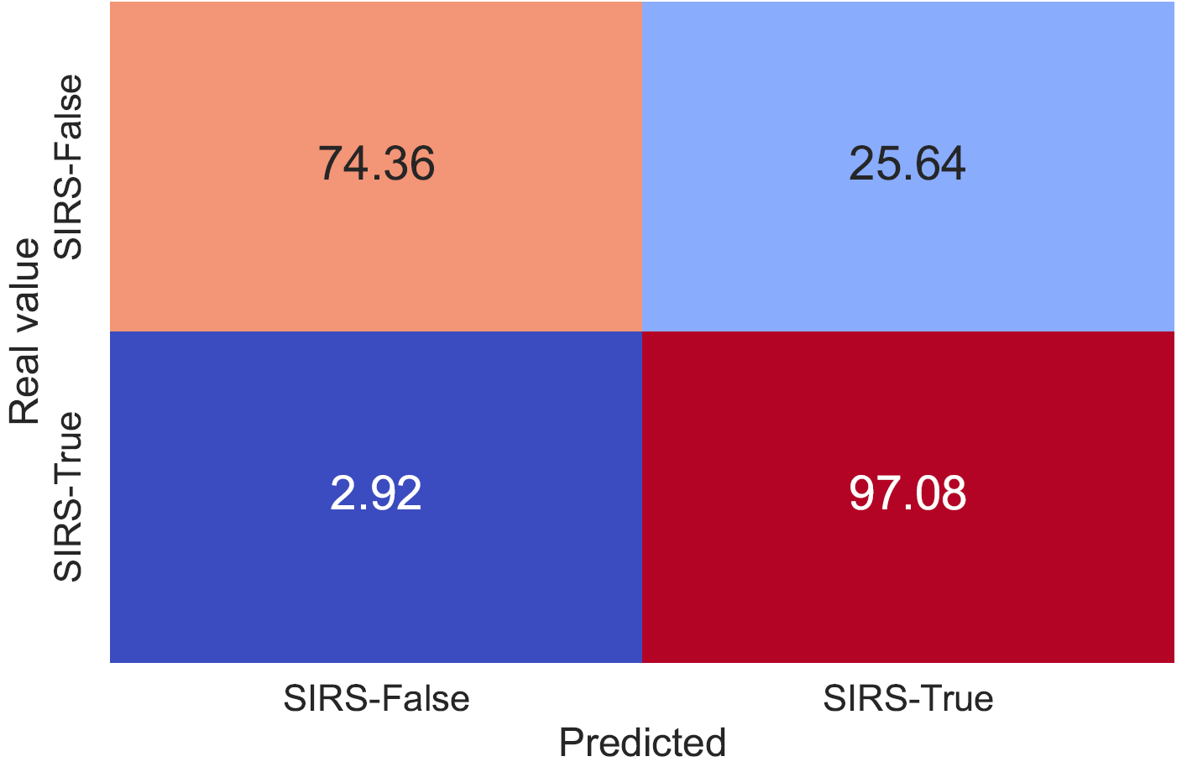
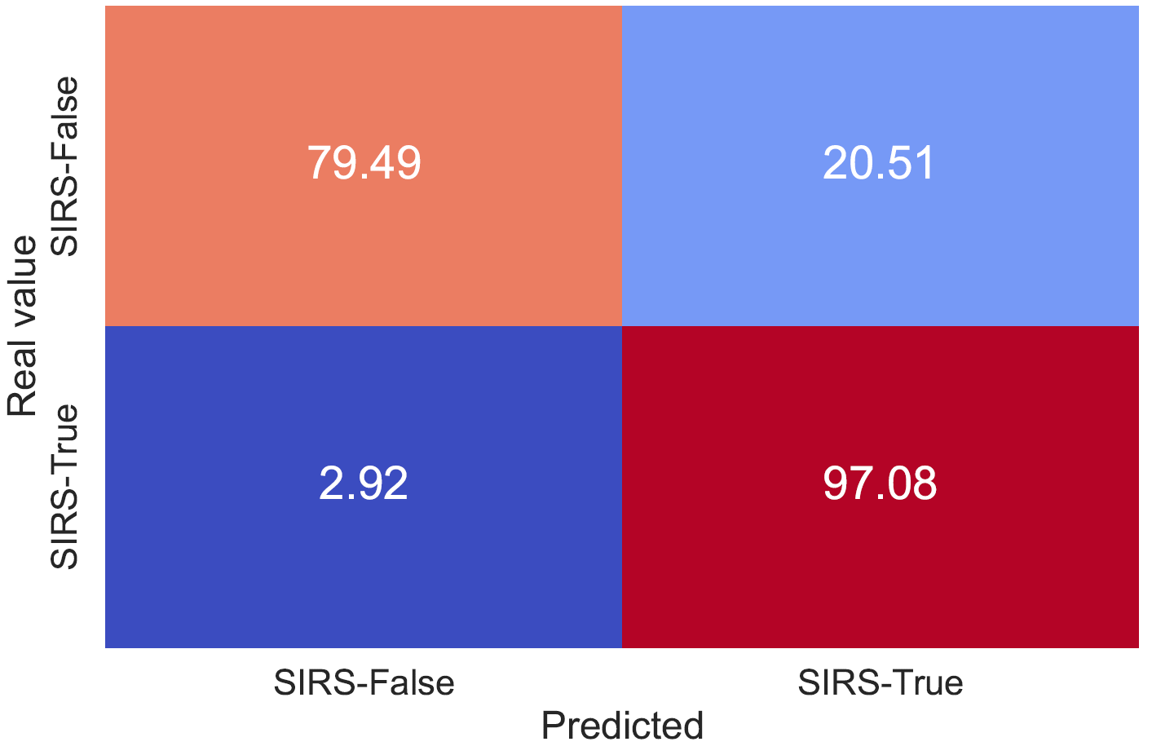
Bag of activities vs DECLARE rules
Sepsis
Bag of activities
Declare rules
Notes:
Small advantage for declare in sirs false prediction

Slide 7
Bag of activities vs DECLARE rules
Sepsis prototypes:
Bag of activities:
SIRS-True: RG, TG, TGS, CRP, LC, AB
SIRS-False: RG, TG, TGS
DECLARE rules:
SIRS- True: RG, TG, TGS, CRP, CRP, LC, AB
SIRS-False: RG. TG, TGS,

Slide 8
Bag of activities vs DECLARE rules
Sepsis boundary cases:
Bag of activities:
SIRS-False: RG, TG, TGS, CRP, LC, NC, CRP, RD
SIRS-True: RG, TG, TGS, LC, CRP, LA
DECLARE rules:
SIRS-False: RG, TG, TGS, CRP, LC, NC, LC, CRP, LC, LC, CRP, CRP, LC, RA, CRP, LC
SIRS-true: RG, TG, TGS, CRP, LC, NC, LC, CRP, CRP, LC, CRP, LC, LC, CRP, CRP, LC, RA

Slide 9
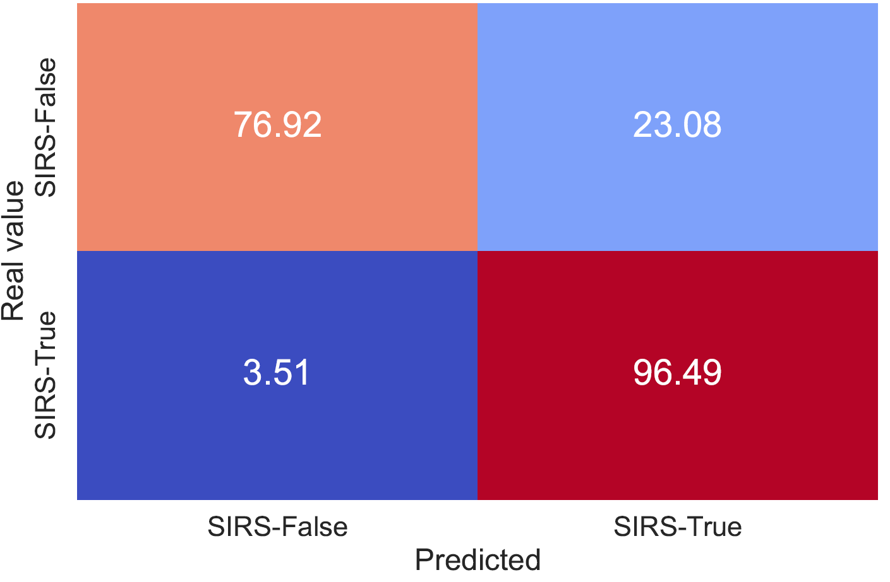
XGBoost VS HistGradientBoosting
Sepsis:
XGBoost
HistGradient

Slide 10
XGBoost vs HistGradientBoosting
Sepsis prototypes:
XGBoost
SIRS- True: RG, TG, TGS, CRP, CRP, LC, AB
SIRS-False: RG. TG, TGS,
HistGradient:
SIRS-True: RG, TG, TGS, LQ, CRP, LC, LA, AB, NC, LC, CRP, CRP, LC, LC, CRP, RA, RER.CRP, LC
SIRS-False: RG, TG, TGS

Slide 11
XGBoost VS HistGradientBoosting
Sepsis:
Intraclass | XGBoost | Hist
SIRS-False | 3390.54 | 3390.54
SIRS-True | 5412.00 | 3345.03
Interclass | XGBoost | Hist
SIRS-False | 6947.33 | 6947.33
SIRS-True | 4404.40 | 6164.36

Slide 12
XGBoost vs HistGradientBoosting
Sepsis boundary cases:
XGBoost
SIRS-False: RG, TG, TGS, CRP, LC, NC, LC, CRP, LC, LC, CRP, CRP, LC, RA, CRP, LC, ---
SIRS-true: RG, TG, TGS, CRP, LC, NC, LC, CRP, CRP, LC, CRP, LC, LC, CRP, CRP, LC, RA
HistGradient:
SIRS-False: RG, TG, TGS, LA, LC, CRP, NC, NC, CRP, LC, RA
SIRS-True: RG, TG, TGS, LA, LC, CRP, NC, CRP, --- , LC, RA

Slide 13
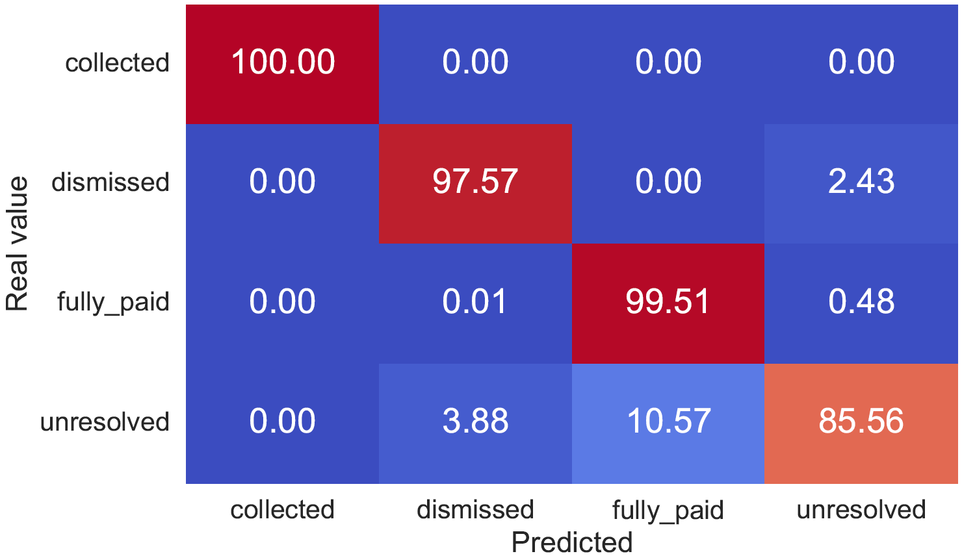
XGBoost VS HistGradientBoosting
RTFM:
XGBoost
HistGradient

Slide 14
XGBoost vs HistGradientBoosting
RTFM prototypes
XGBoost:
Collected: CF, SF, IF, AP, SC
Dismissed: CF, SF, IF, AP, AJ
Fully paid. CF, PYM
Unresolved: CF, SF
HistGradient:
Collected: CF, SF, IF, AP, NR, RP, SC
Dismissed: CF, SF, IF, AP, ID, RP, NR, AJ
Fully paid: CF, PYM, SF, PYM
Unresolved: CF, SF

Slide 15
XGBoost vs HistGradientBoosting
RTFM
Intraclass | XGBoost | Hist
Collected | 107.98 | 3213.66
Dismissed | 3860.16 | 4488.64
Fully paid | 799.06 | 2254.31
Unresolved | 1126.27 | 1126.27
Interclass | XGboost | Hist
Collected | 4195.61 | 5238.04
Dismissed | 3782.72 | 5407.83
Fully paid | 4303.50 | 3749.86
Unresolved | 3449.54 | 3449.54
Intraclass: it is lower in XGBoost so they are more central to its class
Interclass: It is higher in 2 prototypes for Hist, where intraclass is higher than XGBoost so they are
more similar to outliers

Slide 16
XGBoost vs HistGradientBoosting
RTFM boundary cases dismissed-unresolved
XGBoost:
Dismissed: CF, SF, IF, AP, ID, SA
Unresolved: CF, SF, IF, AP, ID, SA, RP, NR, AJ
HistGradient:
Dismissed: CF, SF, ID, SP
Unresolved: CF, SF, IF, ID, AP, SA, RP, NR, AJ

Slide 17
XGBoost vs HistGradientBoosting
RTFM boundary cases fully paid – unresolved
XGBoost
Fully paid: CF, SF, IF, ID, SA, AP, PYM
Unresolved: CF, SF, ID,SA, IF, AP, PYM
HistGradient
Fully paid: CF, SF, IF, AP, AJ, PYM, PYM, PYM, PYM
Unresolved: CF, SF, IF, AJ,AP, PYM

Slide 18
Conclusion XGB vs HIST
Performance is similar in both classifiers
In RTFM log, XGB provides simpler prototypes and those that are more representative for its class. By contrary, HIST provides prototypes more similar to outliers
In sepsis log, HIST provides more representative prototypes

Slide 19
Classifier decline
We have reduced the training data for sepsis and rtfm logs.
Particularly, having 25%, 50% and 75% less training data.

Slide 20
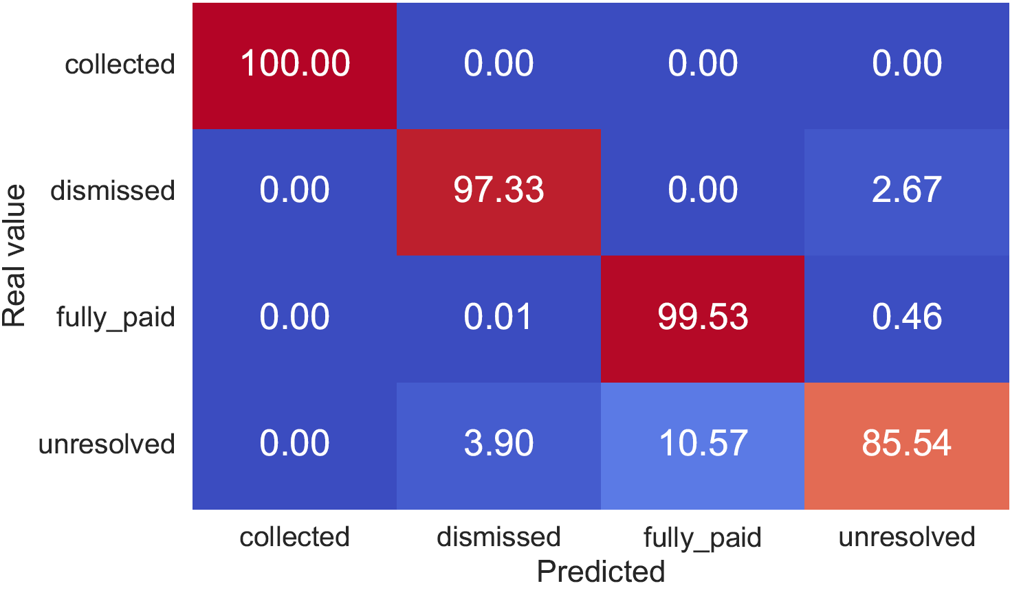
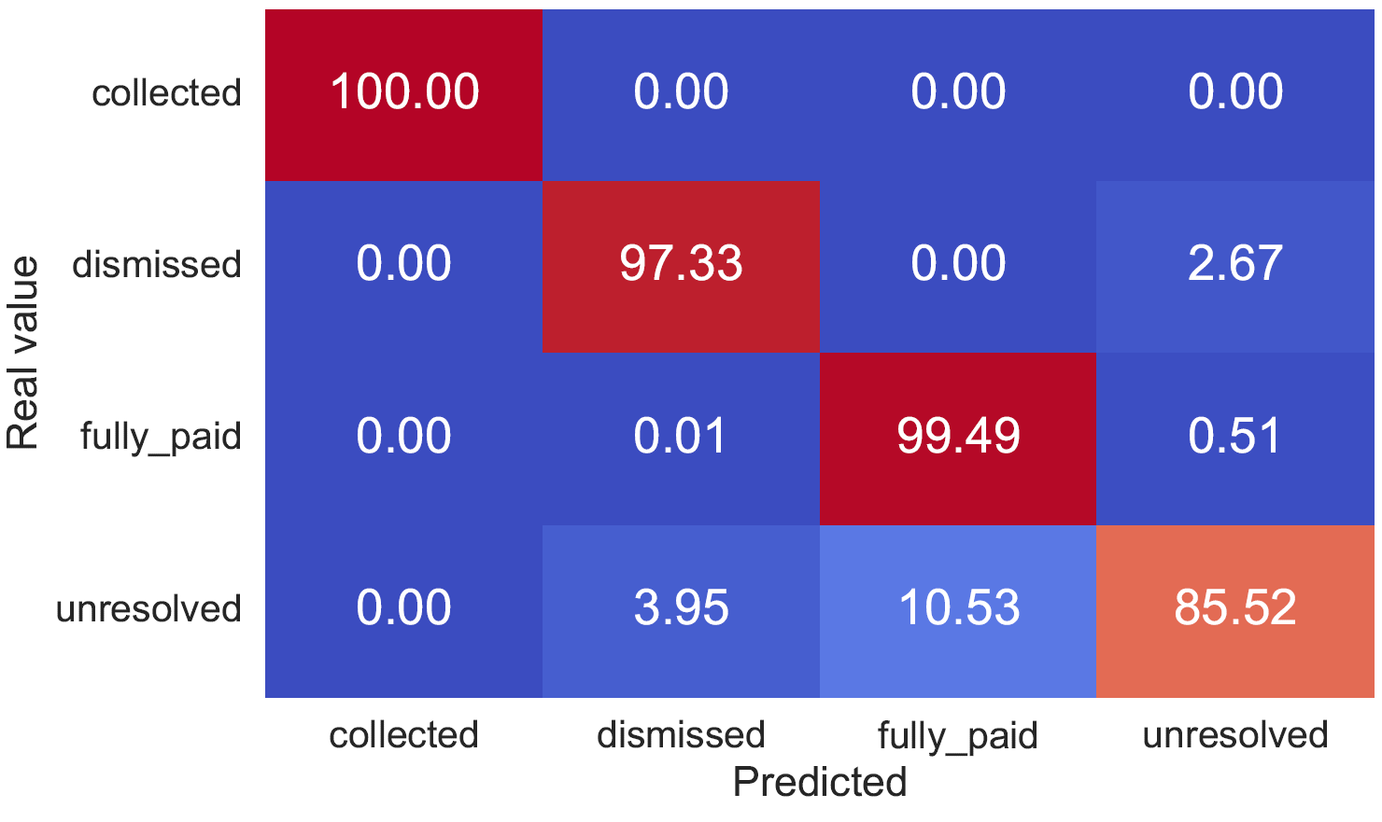
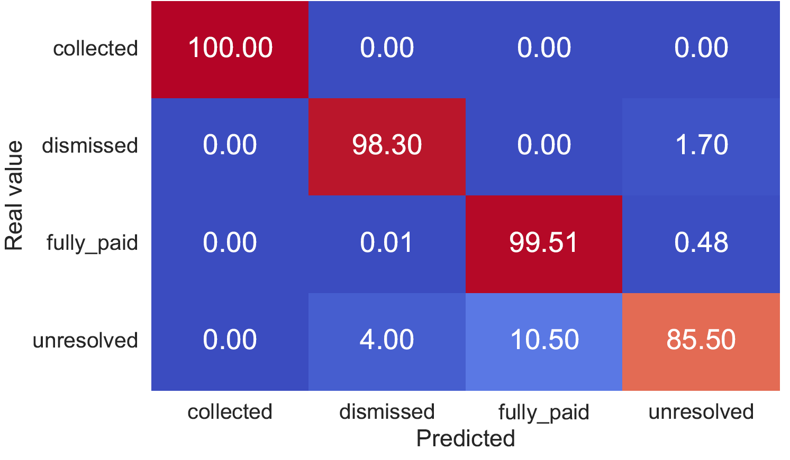
Classifier decline RTFM
75% training data
available
50% training data
available
25% training data
available
There are small variations in the real predictions

Slide 21
Classifier decline RTFM
Are equal… | 75& TR data | 50% TR data | 25% TR data
Unresolved prototypes? | Yes | Yes | Yes
Fully paid prototypes? | Yes | Yes | Yes
Dismissed prototypes? | No | No | No
Collected prototypes? | Yes | Yes | Yes
BCs dismissed-unresolved? | 2/2 | 1/2 | 1/2
BCs fullypaid-unresolved? | 0/2 | 0/2 | 0/2

Slide 22
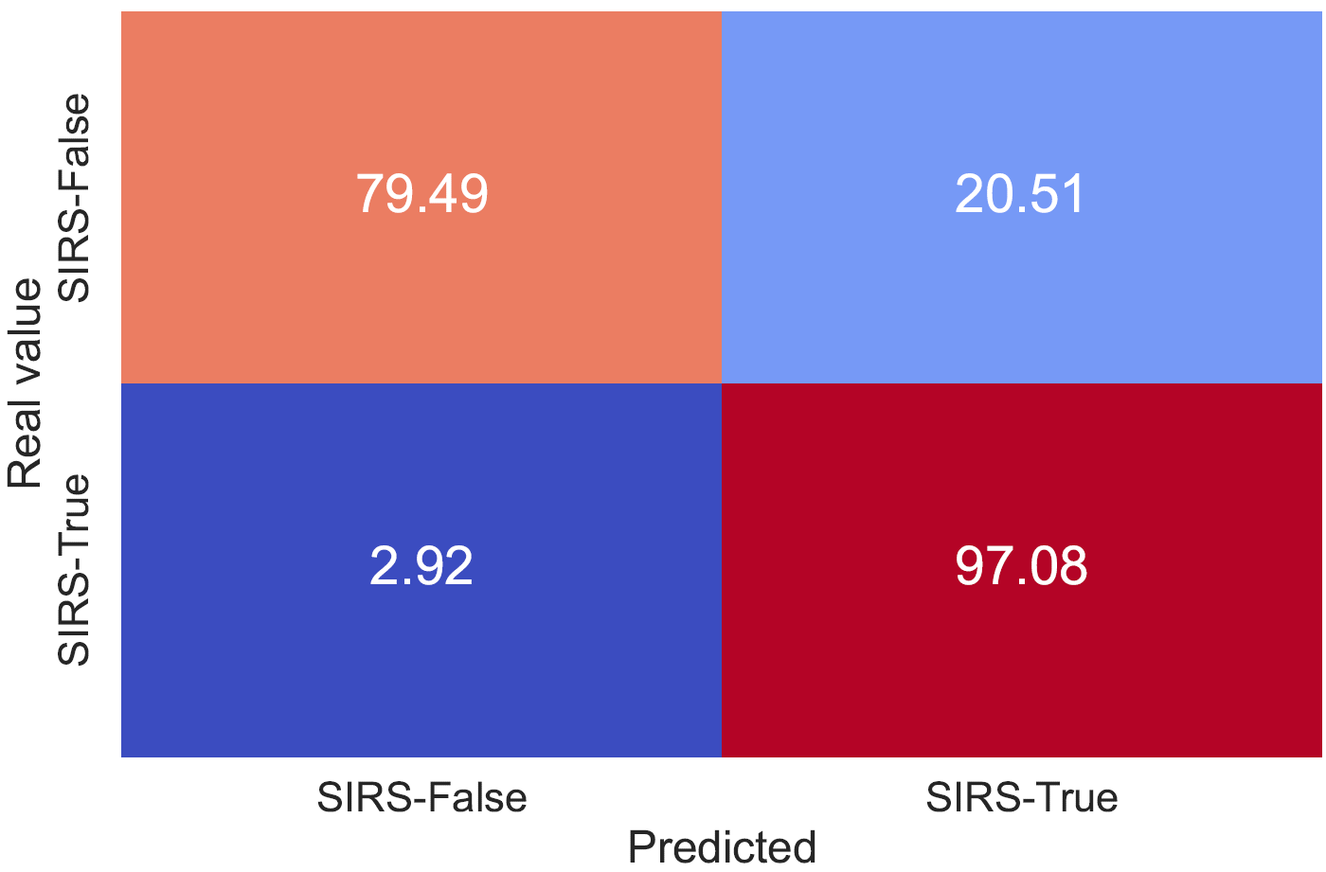
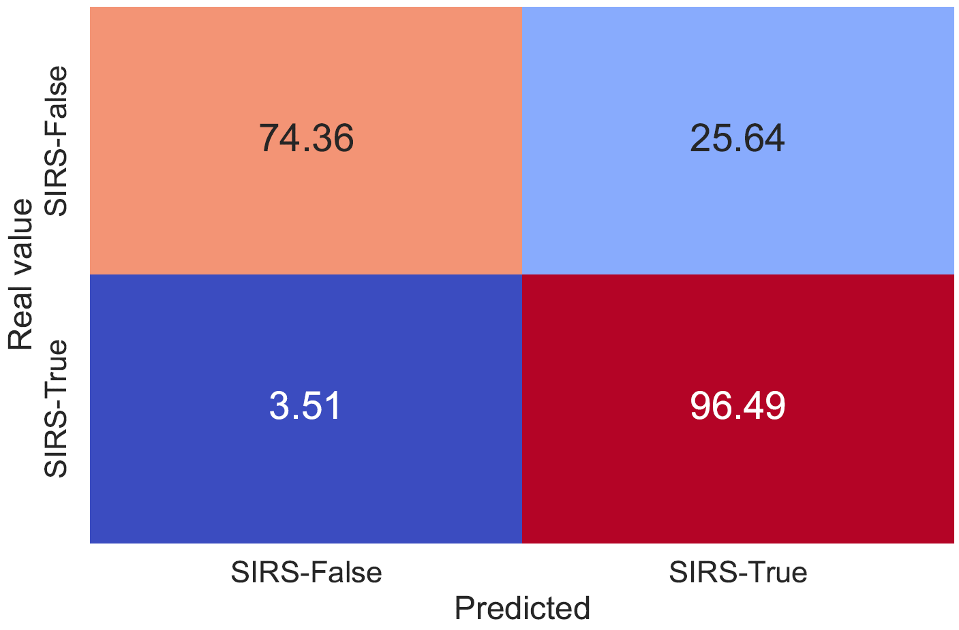

Classifier decline Sepsis
75% TR data
available
50% TR data
available
25% TR data
available
There are small variations in the real predictions

Slide 23
Classifier decline Sepsis
Are equal… | 75& TR data | 50% TR data | 25% TR data
SIRS true prototypes? | No | No | No
SIRS false prototypes? | No | Yes | Yes
BCs SIRS True-False? | 0/2 | 0/2 | 0/2

Slide 24
Conclusions decline of the classifier
Despite providing less data, the approach seems to work consistently for prototypes, but not boundary cases.
Especially, the results vary in the Sepsis log, which makes sense due to its high variance in terms of control flow.

